Slide 1
Graph-based Data Mining in Biological Databases
Larry Holder
Department of Computer Science and Engineering
University of Texas at Arlington

Slide 2
Outline
Graph-based data mining
  Approaches
  SUBDUE system
Applications to biology
  Protein structure
  Chemical mutagenicity
  Biological networks

Slide 3
Graph-based Data Mining
Finding patterns in a graph representation of data
Applications to biological databases
  Genome
    Gene location and transcription factors
  Biological networks
    Reusable sub-networks (sub-routines)
  Proteins
    Structural motifs
    Conformation prediction
  Chemical compounds
    Mutagenicity and carcinogenicity
    Pharmacophores (SARs)

Slide 4
Graph-based Data Mining
Issues in graph representation
  Atom-bond level
  Compound level
  Process level
  3D information
    Distance-inferred influence
    3D coordinates (geometric)
  Summary information
    Attributes of atoms, bonds, compounds, processes
Answer: Depends on the application

Slide 5
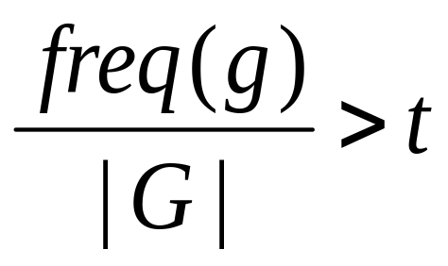
Graph-based Data Mining
Approach #1:
  Find all subgraphs g within a set of graph transactions G such that
  where t is the minimum support
Focus on pruning and fast, code-based graph matching
Notes:
Definition

Slide 6
Frequent Subgraph Mining
Approach #1: Algorithms
  Apriori-based Graph Mining (AGM)
    Inokuchi, Washio & Motoda (Osaka U., Japan)
  Frequent Sub-Graph discovery (FSG)
    Kuramochi & Karypis (U. Minnesota)
  Graph-based Substructure pattern mining (gSpan)
    Yan & Han (UIUC)
  Fast Frequent Subgraph Mining (FFSM), SPanning tree based maximal graph mINing (Spin)
    Huan, Wang & Prins (UNC Chapel Hill)
  GrAph, Sequences and Tree extractiON (Gaston)
    Kazius & Nijssen (U. Leiden, Netherlands)

Slide 7
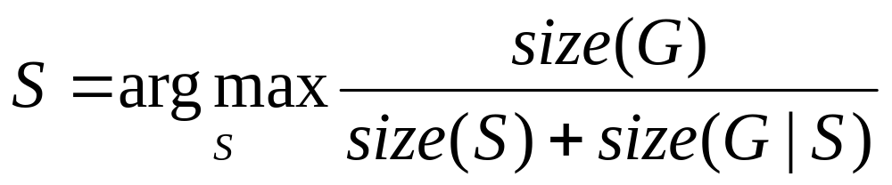
Graph-based Data Mining
Approach #2:
  Find subgraph S within a set of one or more graphs G that maximally compresses G
  where (G|S) is G compressed by S, i.e., instances of S in G replaced by single vertex
Focus on efficient subgraph generation and heuristic search
Notes:
GBI uses joins.
SUBDUE uses one-edge expansion.
[SUBDUE actually originated in 1987.]
Next: Describe SUBDUE…

Slide 8
Graph-based Data Mining
Approach #2: Algorithms
  Graph-Based Induction (GBI)
    Yoshida, Motoda & Indurkhya (U. Osaka, Japan)
  SUBstructure Discovery Using Examples (SUBDUE)
    Cook & Holder (UT Arlington)
Notes:
GBI uses joins.
SUBDUE uses one-edge expansion.
[SUBDUE actually originated in 1987.]
Next: Describe SUBDUE…

Slide 9
Multi-Relational Data Mining
Graph-based data mining
  Represent entities and relations as vertices and edges in a graph
Logic-based data mining
  Inductive Logic Programming (ILP)
  Represent entities and relations as terms and predicates in first-order logic
  (+) Well-defined semantics
  (-) Model-driven (i.e., slower)

Slide 10
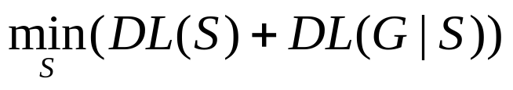
SUBDUE Graph-based Data Mining
Graph compression and the minimum description length (MDL) principle
  The best theory minimizes the description length of the theory and the description length of the data given the theory
The best graphical pattern S minimizes the description length of S and the description length of the graph G compressed with pattern S
where description length DL(G) is a measure of the minimum number of bits of information needed to represent G
S₁
S₁
S₁
S₁
S₁
S₂
S₂
S₂

Slide 11
SUBDUE Graph-based Data Mining
Graph-based hierarchical, conceptual clustering
Use iterative process on input graph G
  Repeat
    Use SUBDUE to find best pattern S in graph G
    Add S to hierarchy
    G = G compressed with S
  Until no more compression
Clustering is a lattice
Clusters described by pattern
  Not just instances as in traditional clustering techniques

Slide 12
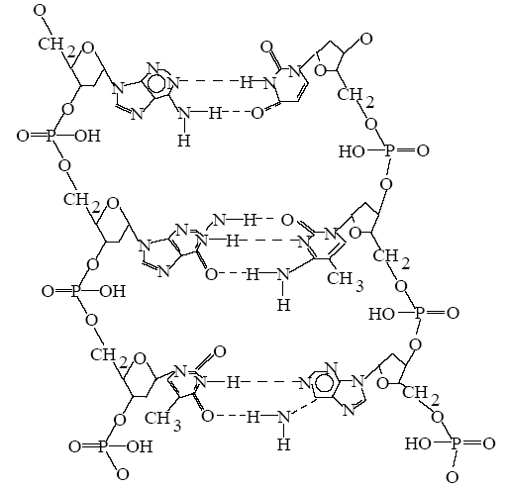
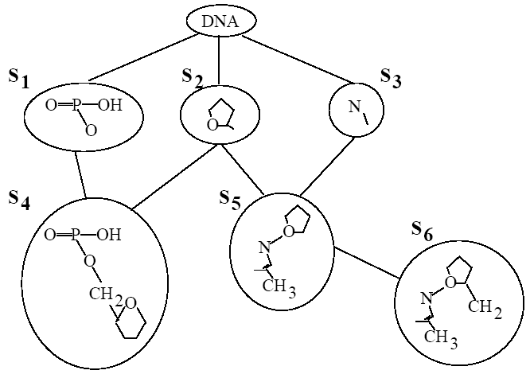
Graph-based Hierarchical,
Conceptual Clustering

Slide 13
Application to Protein Structure
SCOP (http://scop.mrc-lmb.cam.ac.uk/scop)
  Structural Classification of Proteins
  26,000 proteins into 2,800 families arranged hierarchically by structural regularities
Identify structural regularities among proteins in a SCOP family

Slide 14
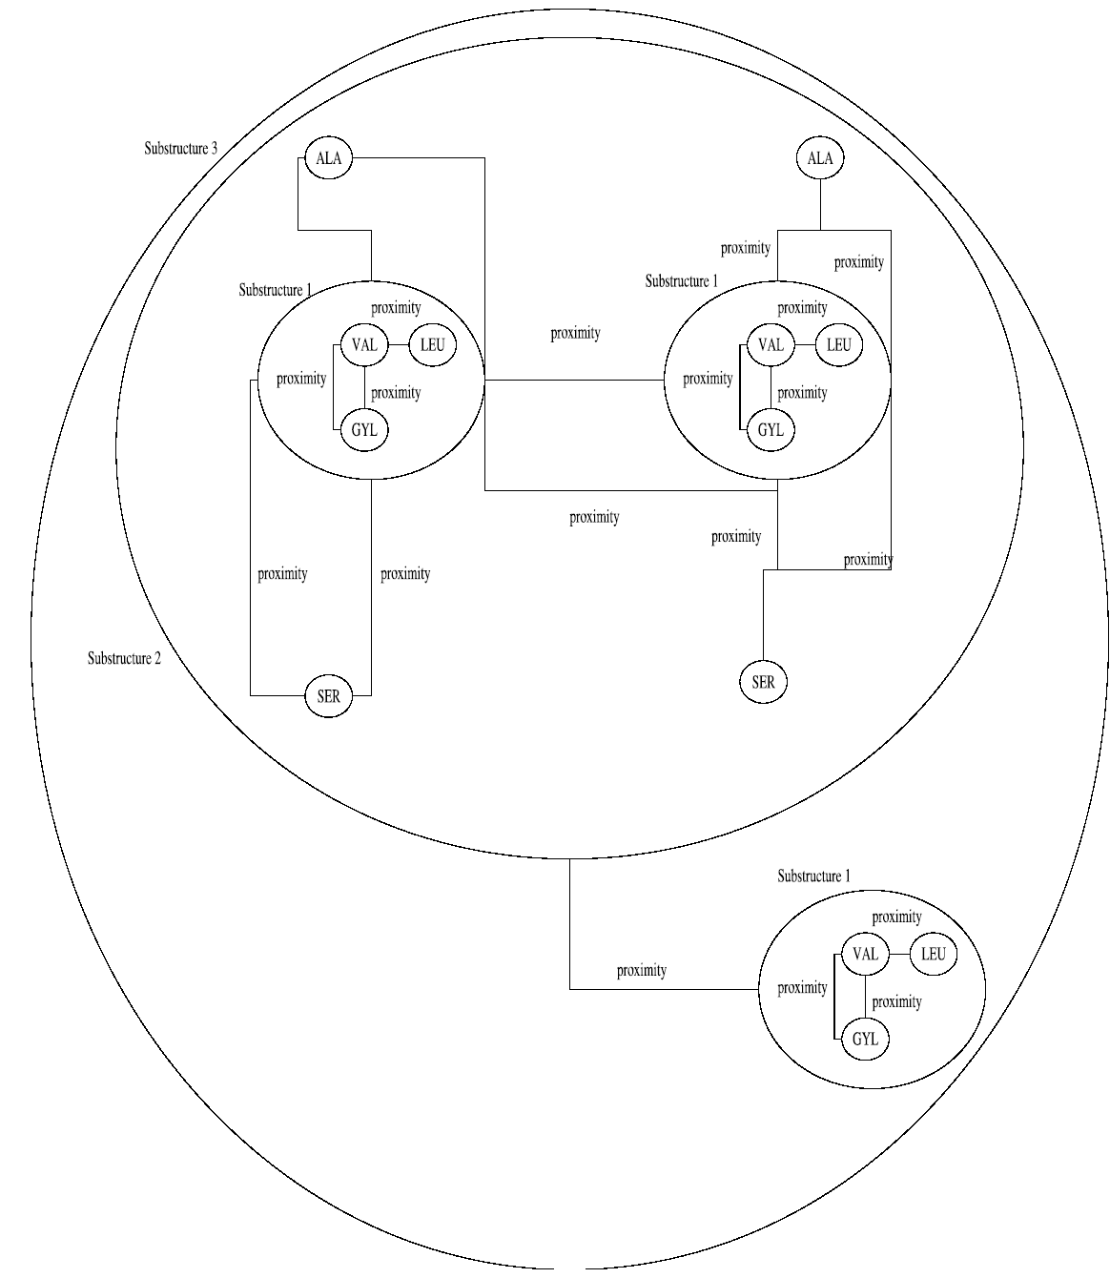
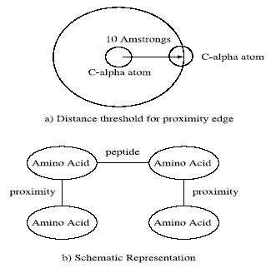
Application to Protein Structure
Representation
Pattern learned in 6 proteins from the
Viral cysteine protease of trypsin fold
family (SCOP ID 50603)

Slide 15
Application to Mutagenicity
Mutagenesis dataset
  230 compounds: 138 mutagenic, 92 non-mutagenic
  Atoms, bonds, atom types, bond types and partial charges on atoms
  Properties related to mutagenicity
    Hydrophobicity (logP)
    Lowest unoccupied molecular orbital (LUMO)
    Three or more benzyl rings (I1)
    Acenthryles (Ia)
Goal: Learn patterns predicting mutagenicity of a compound
  Subgoal: Compare graph-based and logic-based approaches (SUBDUE vs. CPROGOL)

Slide 16
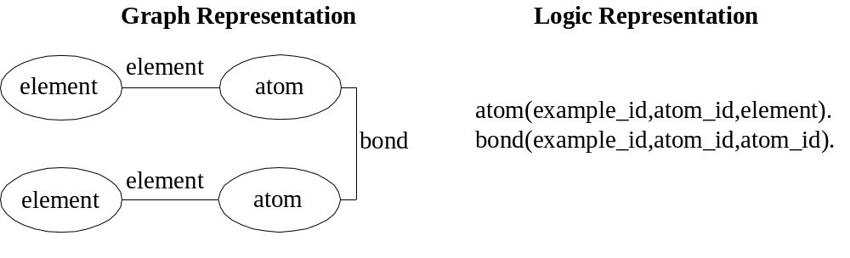
Application to Mutagenicity
Baseline accuracy (all information)
  SUBDUE: 63%, CPROGOL: 60%
Atom-bond structure only:

Slide 17
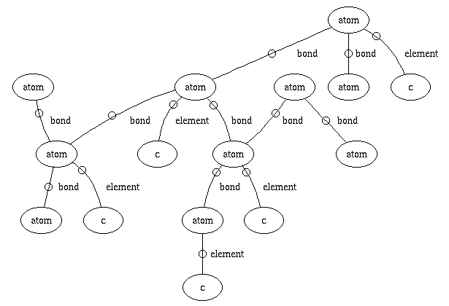
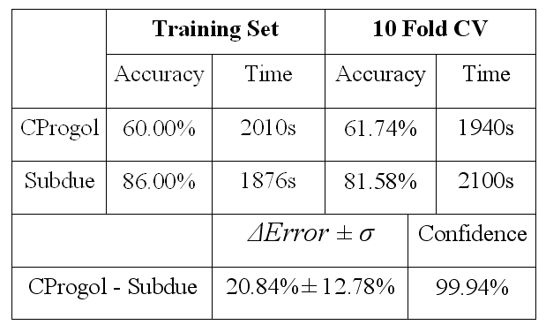
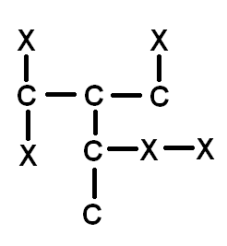
Application to Mutagenicity
Results for atom-bond only representation:
SUBDUE performs significantly better than
CPROGOL.
Best Classifying Substructure
Accuracy: 76.72%
Coverage: 81.15%

Slide 18
Application to Biological Networks
Biological networks
  We can now focus on a system-level understanding of biological systems grounded on a molecular-level understanding
Four aspects of systems biology
  System structure
  System dynamics
  Control method
  Design method
Many potential applications
  Simulation of disease risks
  Drug design

Slide 19
Biological Networks
Three categories of biological networks
  Metabolic networks
    Enzymatic processes creating energy and other parts of the cell
  Protein networks
    Protein-protein interactions implementing signal communications
  Genetic networks
    Regulation of DNA → protein gene expression

Slide 20
Biological Networks
Metabolism
  Series of enzyme-catalyzed reactions
  Constitute metabolic pathways in the cell
Two categories of metabolism
  Catabolism: break down molecules to release energy for biological activity
  Anabolism: construct more complex molecules to support cell function (e.g., polypetides)
Can be reversible or irreversible
Metabolic pathways interact

Slide 21
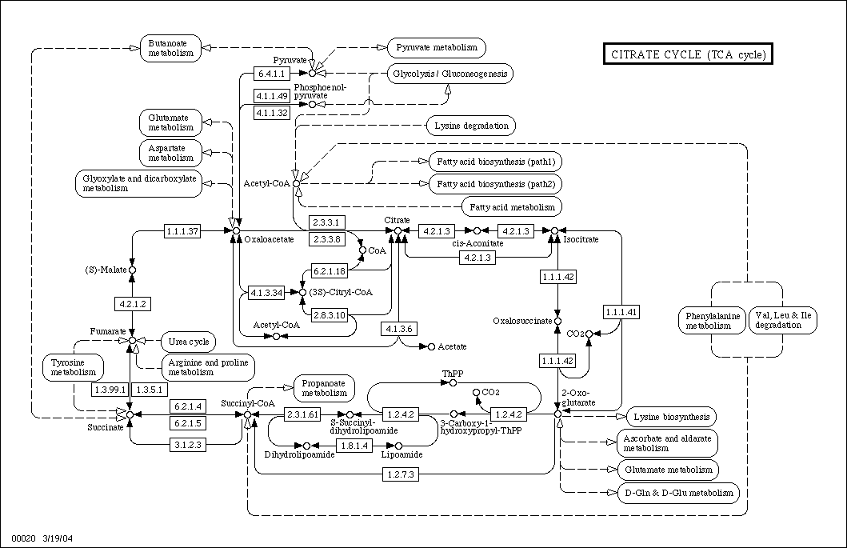
Biological Networks

Slide 22
Biological Networks
Data
  KEGG (www.genome.jp/kegg)
    Kyoto Encyclopedia of Genes and Genomes
  BIND (bind.ca)
    Biomolecular Interaction Network Database
  DIP (dip.doe-mbi.ucla.edu)
    Database of Interacting Proteins
  PathCase (nashua.cwru.edu/pathways)
  BioCyc (www.biocyc.org)

Slide 23
Biological Networks
KEGG PATHWAY database
  31,320 pathways
  239 reference networks
  356 species
    77 eukaryotes
    279 prokaryotes
  KEGG Markup Language (KGML) based on XML
    Supports automated conversion to graph form

Slide 24
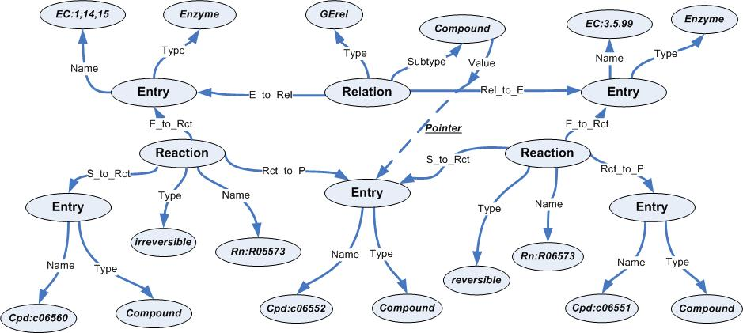
Biological Networks
Graph representation

Slide 25
Biological Networks
Mining tasks
  Supervised learning
    Distinguish networks in one species from those in another species
    Distinguish one network from another network across several species
  Unsupervised learning (→)
    Patterns in several networks in one species
    Patterns in one network across several species

Slide 26
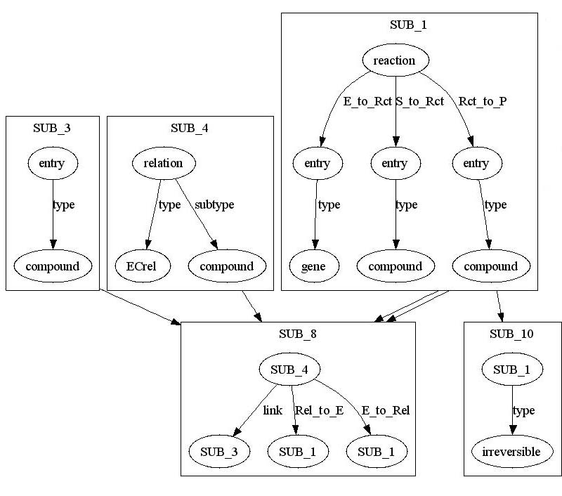
Biological Networks
Pattern (SUB_8) found in 5 fruit fly networks after 8 iterations

Slide 27
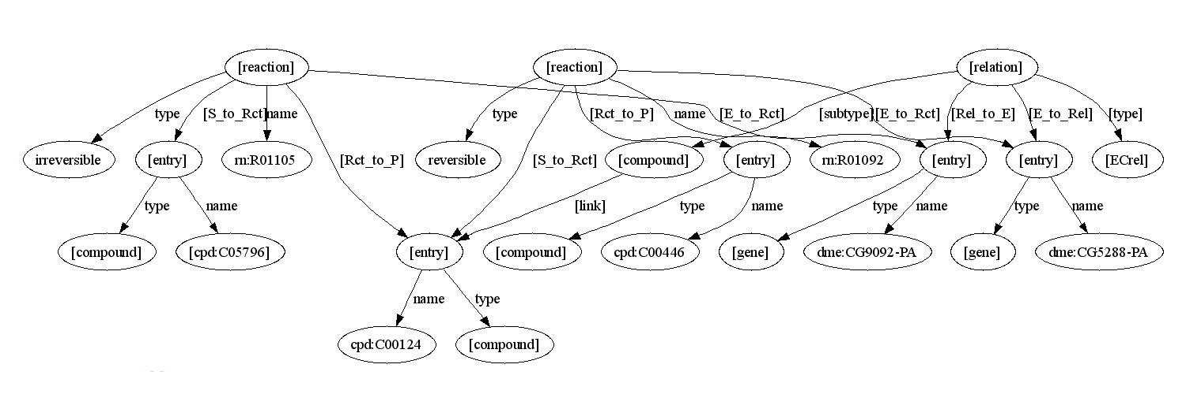
Biological Networks
Instance of pattern (SUB_8) in Galactose metabolism network of fruit fly

Slide 28
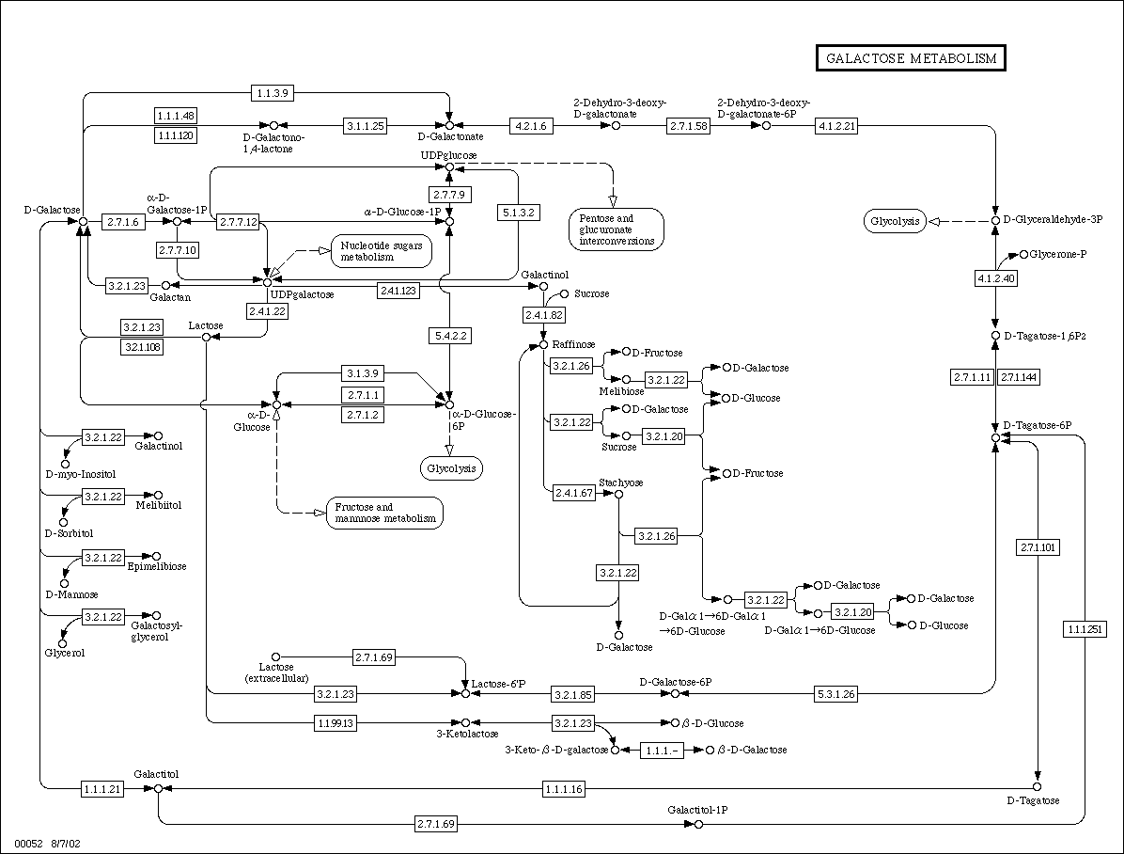
Biological Networks
Galactose metabolism network

Slide 29
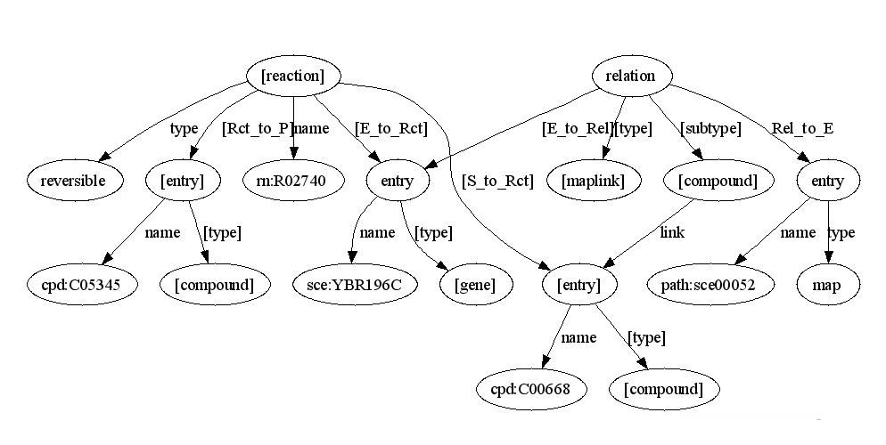
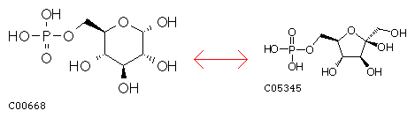
Biological Networks
Pattern in glycolysis network across all species
  Glycolysis metabolizes glucose to generate biochemical energy
Reaction R02740:
Related to
Galactose
Metabolism
(00052)

Slide 30
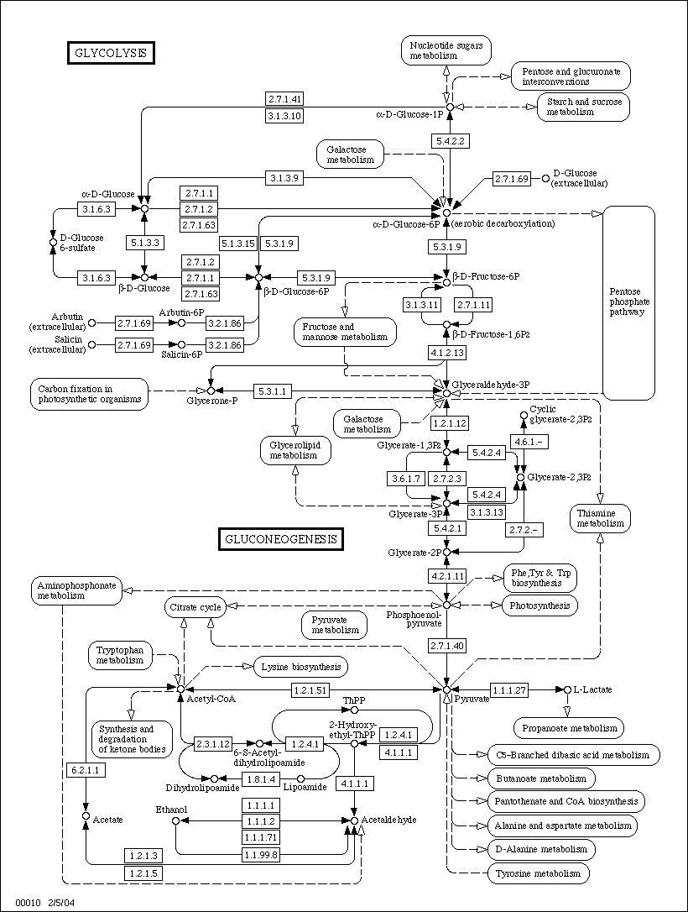
Biological Networks
Glycolysis network

Slide 31
Biological Networks
Related work
  Frequent subgraph mining (Koyuturk et al., 2004)
    Represent pathways as directed graph of enzymes
    Found relevant patterns in specific networks across multiple species
    Exploits graphical constraints of biological networks for efficiency
    Misses relation and reaction information
  Logic-based approach (Muggleton, 2005)
    Predict effects of toxins on biochemical pathways (e.g., hydrazine’s ability to inhibit certain enzymes)
    Application of CPROGOL achieved 82% accuracy

Slide 32
Biological Networks
Related work
  Frequent subgraphs in gene networks
    CODENSE (Hu et al., 2005)
  Network evolution and similarity to networks in other domains
    Barabasi et al., 2004-05
  Find conserved regions of protein interaction pathways
    PATHBLAST (Kelley et al., 2004)

Slide 33
Conclusions
Graph-based data mining ideally suited to biological databases
Numerous successful applications
  Chemical compounds, proteins, genome, metabolic and regulatory pathways
  Useful for understanding and design
Issues
  Alternative graph representations
  Computational complexity
Next steps
  Integration of multiple biological databases
  Mining at various levels of abstraction

Slide 34
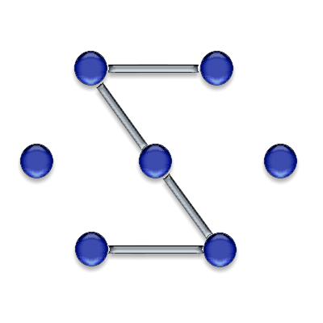
Acknowledgements
Prof. Diane Cook
Students
  Changhun You
  Nikhil Ketkar
SUBDUE system
  http://ailab.uta.edu/subdue

